Slide 1
How To Study Effectively:
A guide for Y11 students and their parents
January 2022

Slide 2
Why are your mock exams important?
GCSE exams are physically demanding – you need to experience what is required before you do the real thing.
The results from your mocks will tell you what you need to focus on to prepare you for the summer.
If exams were to be cancelled in the summer, mock results can form part of the information we will use to decide on teacher assessed grades.

Slide 3
The plan for this term
14th January: help session on how to revise effectively
20th January: latest set of Y11 predicted final grades
7th February – 4th March: Mock exams
7th February: school informed of advance information about what is on your actual GCSE exams
17th March: mock results morning
30th March: targeted Y11 parents evening

Slide 4
Conduct in exams
Make sure you are equipped for your exam.
Meet on the stage. Bottles need labels to be removed. Pencil cases must be completely transparent.
Phones – switched off and either left in bags or handed in to invigilator on entry to hall.
Walk into hall in silence. Sit in your seat in silence.
Inappropriate communication at any time in the hall can result in removal from that exam and other exams.
Any questions – invigilator only.

Slide 5
Starting point
Know your exam board for each subject
Get yourself organised – good writing pens, highlighters, A4/A3 paper, writing book for each subject, flashcards, blutac, past exam papers, youtube clips, water bottle, treats/food for breaks (ask your parent/carer to sort this out )
Create a space for you to work - if you don’t have your own room, you must chat to your parent/carer about creating a space for you to have as your own
Clean your bedroom – therapy cleaning – helps physically and spiritually

Slide 6
Here comes the challenging bit….
Challenge 1
START REVISION…..this is such a challenging thing to do, actually sitting down and starting your revision.
However, if you put in place all the things I have suggested, it shouldn’t be too difficult.

Slide 7
Challenge 2
Get rid of all distractions
Give up your phone when doing revision….!!!!!
Turn it off and hand it to a family member. Turn off the tv – tv programmes/box sets/Netflix/Prime will all be there after your exams

Slide 8
Step 1: What do you need to study?
Be specific! Don’t say “I’m revising history”. Better to say “I need to learn how public health issues caused a crisis in industrial Britain”
Feedback from your teachers/test results should tell you specifically what your “to do list” looks like.

Slide 9
Step 2: How to study
Have a plan/timetable that is reviewed weekly.
Revision timetable
Don’t break the chain!
Maximum 30 minutes per session, then have a break (and a reward)
Have an objective for each session – “In this session I am going to revise multiplying fractions”.

Slide 10
Create your own flashcards

Slide 11
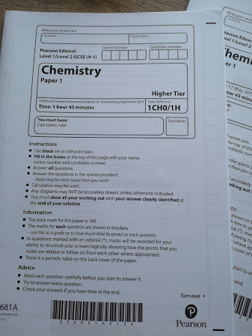
Practice past paper questions

Slide 12
Purchase revision books to read and make notes from

Slide 13
Purchase exam board flashcards – good for information and exam questions

Slide 14
Record your learning onto your phone and listen back to it

Slide 15
Maths Watch
Use Maths Watch to access videos, questions and tasks

Slide 16
Youtube clips
An Inspector Calls (2017) - YouTube
https://www.youtube.com › watch

Slide 17
How to study
Don’t just read, watch videos or copy notes.
Identify the key information – if you only remember two things about a topic, what are they?
Thinking Hard Booklet

Slide 18
Retrieval and Spaced Practice
Retrieval is the act of recalling information without having it in front of you.
Use your knowledge organiser to practise retrieval. See how much you can remember, then look at your knowledge organiser and see how you did. Repeat each week.
Spaced practice says that short bursts of revision over a longer period of time are more effective than cramming.

Slide 19
Cornell Notes
Don’t just copy out existing notes over and over again.
Reduce the notes into a few key sentences.
Finish with a one line summary of the notes.
Cornell Notes example

Slide 20
How do I know I have learned it?
Try to reproduce from memory, then compare to original notes/answers.
Do lots of practice questions – hand in for marking or use self marking apps.
Pixl Apps for Maths, English Lit and Geography. They all have the same login details:
School ID: TS1214
User ID: Surname followed by initial e.g. COYLES
Password: password

Slide 21
How do I know I have learned it?
Science use Tassomai and Educake – all students have login details.
MFL - Linguascope

Slide 22
You can do this!
You are doing brilliantly.
We are with you and together we are going to make this happen.

