Slide 1

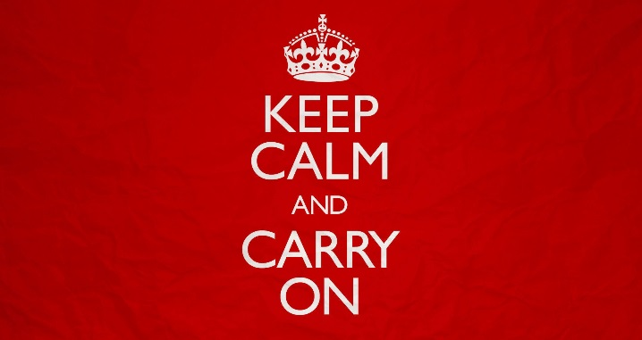
Escalation:
Top 10 do’s and don’ts when it comes to escalation with your child:
What to do:
- Stay calm
- Stop and think
- Remain positive
- Give yourself time to plan your response
- Be non-judgemental
- Remind yourself you’re doing the right thing
- Be gentle and firm
- Persist
- Walk away
- Believe things can get better
What to avoid:
- React
- Talk too much
- Argue
- Lecture
- Threaten
- Raise your voice
- Use sarcasm
- Blame
- Say hurtful things
- Use aggressive body language.

Slide 2
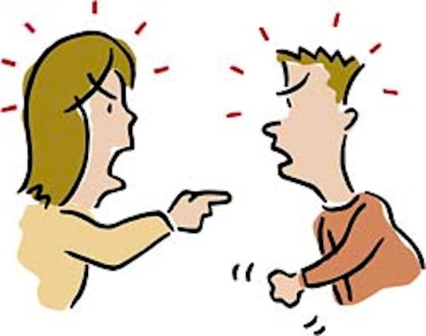
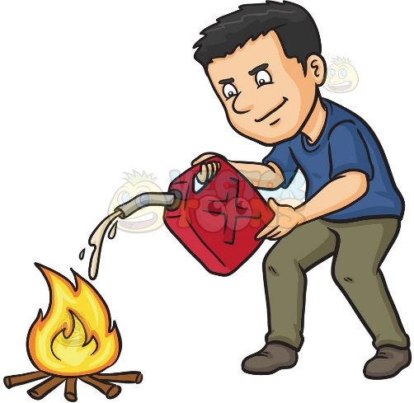

Different types of escalation:
Joint escalation:
Your child raises their voice, you raise yours, your child shouts, you start to shout, your child shouts louder, you shout louder. The argument can end in violence on both sides
Parents sometimes see their children as arguing with them, making threats and expressing anger. The natural response of most parents is to try and get back in control, making threats back or demanding punishments.
In most cases, this further angers the child, and is almost like throwing fuel on the
fire. They get more angry,
you get more angry and
things continue to escalate and
you end up in a battle of wills,
Neither one of you wanting to
back down
In these times, you’re fighting a losing battle. Your child is always willing to go one step further than you’re ever going to go. Each times you go further before giving up, the bench mark gets higher, and the line to beat goes up and up.
Giving-in escalation:
Your child shouts and demands, after a while you give in and let your child have their way. Your child learns that they get their own way if they make enough fuss and will repeat the pattern as often as
they can. Each time this happens
you set the bench mark at what
point you will give in. This bench
mark can get higher and higher
each time.

Slide 3
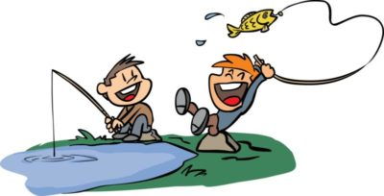

De-escalation
De-escalating the situation removes the power away from the child. The parent takes the lead and controls their reactions and does not allow the child to reel them in.
Notice if you’ve been hooked, and take time to step off the rollercoaster. Avoid getting into lengthy discussions with your child and avoid getting into ‘lecture mode’. This is how your child will draw you into the game, a game which you will undoubtedly lose.
Pause and postpone
Pause and postpone is one of the strongest tools in a parenting toolbox. Taking the time to get your thoughts straight rather than making a rash decision is a really good way of removing the power from the child, showing them that they don’t have the power to make you react in a specific way which means they get what they want.
Using phrases such as ‘I’m going to take some time to think about it’ followed by staying silent is a clear way of showing the child that you’re independent of their control and are taking lead of the situation yourself. By staying silent and not getting into further discussion you’re left with the final say. Walk away, do something to distract yourself.

Slide 4
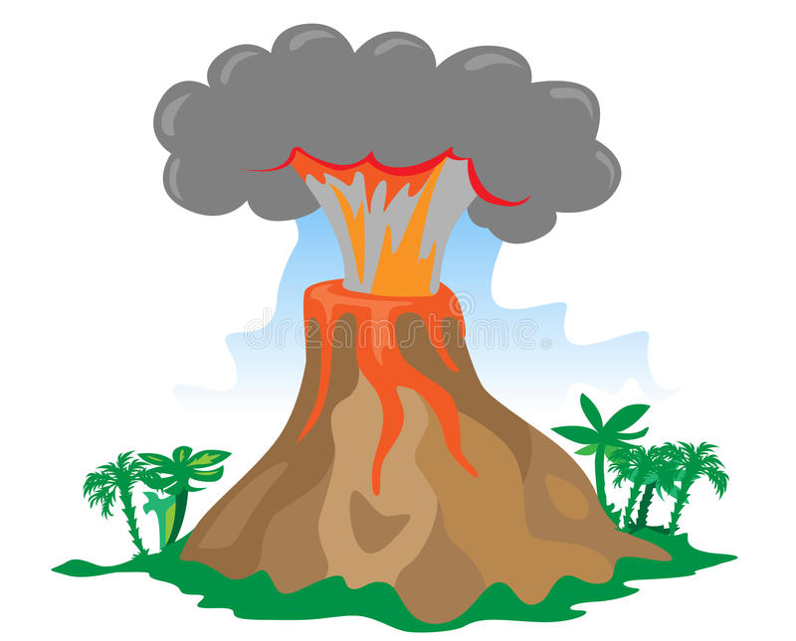

Wait, you want me to give up?! You’re letting them win!!
Lots of parents find the idea of avoiding argument and walking away as giving up/backing down. They feel like they’re reinforcing to their child that they have no power or control, it feels like their child has won.
By walking away, you’re in control
Your child sees escalation as a game. I shout, you shout and we go on until you back down and I win and get what I want.
By taking away your role in this, we don’t get to a point where the child wins… ‘I shout, you walk away….’ and the escalation ends. The important part is addressing the incident when things are calm.
Strike when the iron is cold
Addressing incidents whilst things still feel heated means there is more chance that things could explode again, and we’re back to square 1 and back to de-escalation. You could go
round this cycle time and
time again without moving
forward or seeing anything
change.
The concept of striking when
the iron is cold is to address an incident when everything is properly calm. This could even be days after the incident has happened! It gives you and your child space to think about what has happened, and when you do come to talk about it, you’re able to be much more rational and reasonable. There’s less chance that things will explode again as you’re not feeling angry, and the chance of being able to address what happened and come up with a plan is much higher. There is much more chance that your child will engage.

