Slide 1
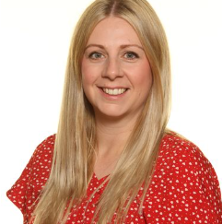
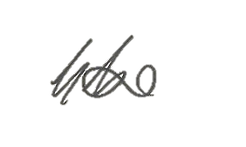
A Parents’ and Carers’ Guide to Supporting
Transition from Primary School to
St Thomas More Catholic Voluntary Academy
Hello and welcome to our transition guide for Parents and Carers of our future St Thomas More students. A sincere and warm welcome to the St Thomas More community. The transition from Primary to Secondary is an exciting time but it can also be challenging and a little bit daunting as you and your child adapt to somewhere new. This guide is designed to help to support you and answer any questions about the next few weeks, months and years of your child’s time at St Thomas More.
I look forward to meeting you and getting to know you and your child as they begin their transition journey to STM.
Yours sincerely,
Mrs K Taylor
Transition Lead and Head of Learning for Year 7

Slide 2
Contents
Helping your child manage the transition to
St Thomas More 3
Preparing for Year 7 at St Thomas More 4
What to do if transition is difficult 5
Communication with St Thomas More 6
Transition Dates 7
September 8
Advice from parents who have children at St
Thomas More 9
Recommended reads for children as they
transition from Primary to Secondary school 10

Slide 3
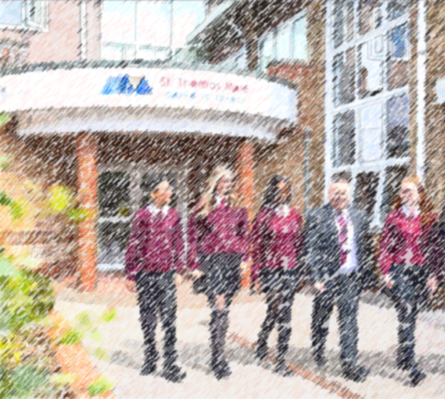
Helping your child manage the transition to St Thomas More
The transition from Primary to Secondary school can be one of the biggest journeys that your child has made so far. It is completely normal that they experience a range of emotions – from excitement to nerves and worry. We always encourage children to talk as much as possible about how they are feeling. As parents, let your child know that it is normal to feel how they do and reassure them that everyone will be feeling exactly the same, even if they don’t admit it.
The majority of our Year 7s report feeling completely at home even after day 1!

Slide 4
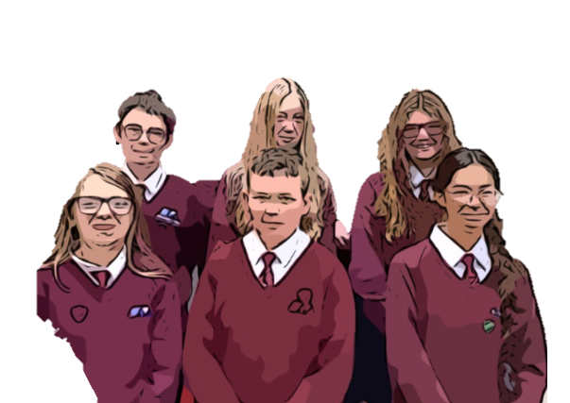
Preparing for Year 7 at St Thomas More
One of the most exciting things for your child – will be obtaining their new school uniform and equipment. A full list of both can be found on our website here: https://www.stthomasmorebuxton.srscmat.co.uk/parents/uniform-and-equipment/
We will provide your child with checklists before the summer holidays so that they can take responsibility of making sure they are prepared and ready. It is really important to give them some ownership of their organisation as they move into secondary school as this is one of the skills they will develop quite quickly once they start.
We will also provide your child with log in information for our SeeSaw app. This is completely safe to use and it allows children to complete mini challenges set by their new teachers with the aim of giving them the opportunity to showcase their talents and ideas before they start whilst learning more about their new teachers.

Slide 5
What to do if transition is difficult
In most cases, our transition programme helps children settle in quickly, and we’re proud that many of them tell us they feel happy and comfortable almost right away.
It’s completely normal for children to feel a little nervous or anxious during times of change. However, if you notice that your child is experiencing particularly high levels of worry, it’s important to talk to someone. Start by speaking with your child’s primary school teacher - they may be able to share your concerns with us, or you can contact us directly using the details provided on the next page.
Take time to talk with your child and try to understand what’s behind their feelings. Are they worried about lessons, making friends, or finding their way around? Identifying the cause can help you reassure them and begin to ease their concerns.
Explore our school website and Facebook page together. Familiarity can help reduce anxiety, and the more your child knows about their new school, the more confident they’ll feel.
Remind them of all the exciting opportunities ahead - making new friends, joining lunchtime clubs, taking part in science experiments, or cooking in food technology.
Connecting with other parents can also be reassuring and give you insight into how other children are adjusting and being supported.
Finally, support your child’s well-being by encouraging healthy habits. A good night’s sleep, reduced screen time, and some fresh air - perhaps during a walk and chat - can do wonders for easing worries and opening up conversation.

Slide 6
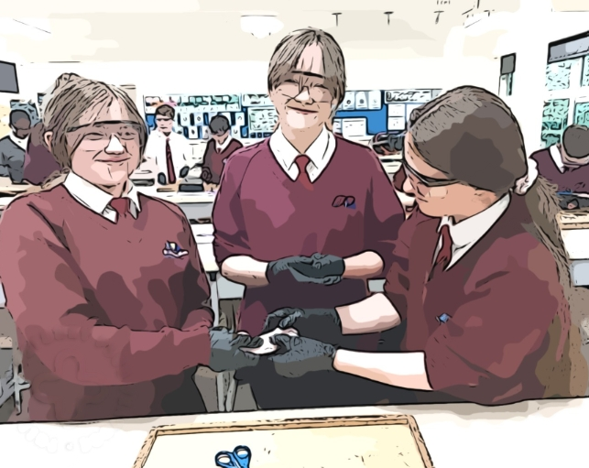
Communication with St Thomas More
We will soon be sending you an email to ask you for your up-to-date details, please do look out for it. We understand that between you completing the application in October last year and now, a lot can change. It is important that we have your correct contact information as we will be sending things out intermittently over the course of the next few months.
Understandably, the transition will bring about plenty of questions. Our website contains a wealth of information about our school – including term dates, uniform and equipment lists, curriculum information and more.
We also recommend that you follow our Facebook page to give an insight into our day-to-day activities.
If you have a specific enquiry that cannot be answered by our website, then you can contact our Office Team on 01298 23167 or email:
General enquiries - enquiries@stm.srscmat.co.uk
SEND enquiries - stmsend@stm.srscmat.co.uk
When your child is officially on roll at the start of September, our main form of communication to you, will be via text message.

Slide 7
Transition dates
Further information for all events below will be sent closer to the time.
Our main transition days will be on Thursday 3rd July and Friday 4th July, 9am – 3pm. All Year 6 students will attend, it is a great opportunity for them to meet one another and their new teachers. Students can wear their own clothes and should bring a bag, pen, pencil and water bottle with them.
We will have a welcome evening 6 -7:30pm on Wednesday 9th July where we invite all parents on their children into school to discuss key information for September and Year 7.
We do offer and enhanced transition programme for some students who require extra support. Places for this are limited and most students will not require this programme. These will be invitation only and we will discuss which of our new cohort most need a place with each of our feeder Primary schools. The dates for our enhanced transition sessions are Thursday 19th June, Thursday 26th June and Thursday 10th July 1:30 – 3pm.
For all transition dates, please arrange transport to and from school for your child. If you wish for you child to walk independently, this is OK but please ensure your child is aware. Mobile phones are not permitted to be on during the school day but children are allowed to have them switched off and in their bags.

Slide 8
September
Your child’s first school day will be on Monday 8th September 2025. Your child should arrive at school between 8:30 and 8:45 in their new school uniform and make their way to the playground (we will show them this on their transition days).
On their first day, our school will be open to Year 7 only. This will give our new Year 7s chance to get to know their way around their new school and meet more of their new teachers. They will spend their first day getting to know each other, their Form Tutor and more about their new school.
Our canteen will be open to students at break and lunchtime or students can bring snacks and packed lunches if they prefer.
It does take roughly a week to set up ParentPay for you to top up your child’s account. During this first week, any canteen items purchased will be on loan until you are able to log in. Once log in information has been sent out, you will be able to view what items your child has been purchasing from the canteen.
During the first term, we will also send you log in information to Arbor, a platform where you will be able to keep track of your child’s behaviour and ASPIRE points awarded from their teachers, as well as their attendance and punctuality to lessons.
You will also have access to Fusion, our VLE. Here you can see what homework tasks your child has been set. Whilst we encourage our students to take responsibility for their homework, we find the most effective home learning is done when parents show an active interest in what skills/knowledge their children are demonstrating when completing homework tasks.
To ensure your child has the smoothest possible start, their uniform and equipment should be in line with our policy from their first day. We appreciate your support with this.

Slide 9
Advice from parents who have children at St Thomas More
“Come to the transition evening to get a feel for the school and hear more about what the day-to-day looks like and what the expectations are.”
“Follow the STM Facebook page and FOSTM Facebook page to keep up to date with what's going on in school.”
“Come to the Year 7 welcome evening, it's a great way to see how your child is settling in. You can also meet their friends and other new starter families as well as their form tutor”
“Do join FOSTM (our PTA). It's a good way to meet staff, find out what's happening in school and be able to come in to school and see for yourself.”
“Parents evening is a great way to meet teachers and other staff as you spend much less time in school than when children were in primary.”
“Don't leave buying uniform too late as you can't always get what you want. Book an appointment at Classworx for the logo items, especially for Year 7 as it can be hard to work out the sizes just from the website, and Classworx get very busy as they serve a number of schools. Classworx do bring sample uniform to the Transition Evening but there can be long queues to look at it. They also offer a discount for early orders in July. ”
“Look out for pre-loved uniform sold at school by FOSTM at the end of summer term, usually on one of the Year 6 transition days.”
“If using public transport, maybe take your child on the journey they will make to school2
“Set a reminder alarm every other Sunday evening, to check if ParentPay needs to be topped up. There is no grace for children to “owe” so would go without a meal if account is empty.”
“Print your child’s timetable & stick it inside the breakfast cereal cupboard!! This way the days lessons can be viewed at a glance, quick check they have their PE kit or Food Tech ingredients & it’s a cupboard that is opened each morning. The week 1/week 2 gets very muddling, particularly around half terms etc so mark each off on the calendar!”
“‘5 years seems like it will last a long time, but within the blink of an eye your young child will have developed into a young adult. I would therefore advise to get involved in all aspects of their journey through secondary from supporting with homework and extra-curricular to involvement in whole school activities. You will be helping and supporting your child at a time they need it as well as you both having memories to cherish that will last a lifetime. It’s the little things that matter.”

Slide 10
Recommended reads for children as they transition from Primary to Secondary school
The Gifted, The Talented and Me, William Sutcliffe
Fiction. A brilliantly funny book about fitting in, falling out and staying true to yourself.
Jelly, Jo Cotterill
Fiction. A real-world story about body positivity, humour as self defence and celebrating who you are.
You are Awesome, Matthew Syed
Non-fiction. Practical, insightful and positive. This book will help you to embrace mistakes and build resilience.
You are a Champion, Marcus Rashford
The nation’s favourite footballer shows you how you can achieve your dreams in this positive inspiring guide to life.
Fight or Flight, Winners of a Nationwide writing competition
Showcasing the work of winners of a short story writing competition including 19 current STM students.

