Slide 1
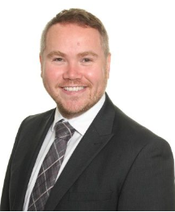
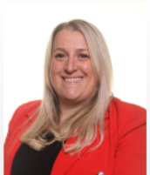
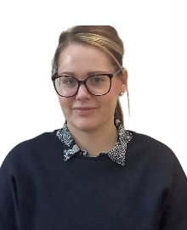
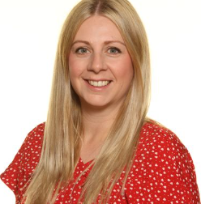
Hello from us
We're thrilled that you've chosen to join us in September and look forward to meeting you during our transition days. In the meantime, we thought you'd like to meet a few key members of our team and learn a bit about what they do here at St Thomas More.
Mr Redfern is our Headteacher and is responsible for leading the entire school, making sure everything runs smoothly for both students and staff.
Mrs Lancett is our Deputy Headteacher and also our SENDCO. She makes sure you get all the help and support you need to succeed in your lessons.
Mrs Taylor is our Transition Coordinator, so you'll be seeing and hearing from her quite a lot over the next few months. She also teaches Maths and is the Head of Learning for Years 7 and 8.
Miss Ward is our Pastoral Manager for Years 7 and 8. She works closely with Mrs Taylor and the Year 7 Form Tutors to make sure you feel happy, safe, and ready to learn.
You can see more of your new teachers and support staff on our website – go to the ‘Our School’ tab and look for ‘Meet our staff’.

